Slide 1
Sizewell C update 2023
Blythburgh Parish Council Meeting
  Monday 27th November 2023

Slide 2
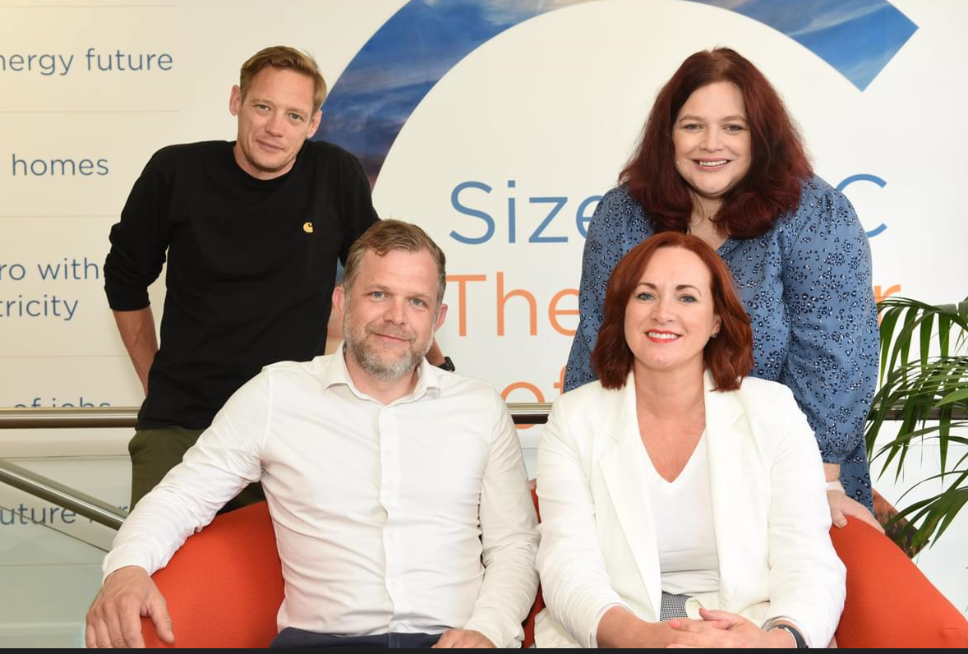
Community Relations Team
Paul Lennon – Michelle Emmerson Grey
Senior Community Relations Manager for Residents and
Land. Paul’s team is responsible for engaging with residents
and landowners regarding the project, addressing enquiries
and/or any concerns they have.
Richard Knight – Zoe Botten
Senior Community Relations Manager for
community governance and will engage with Parish
Councils and local authorities regarding project updates and the
future governance of the Deed of Obligation.

Slide 3
Effective Relationships
Accountability
Honesty
Listening
Open Communication
Trust
Mutual Respect

Slide 4
Deed of Obligation
Resourcing of local authorities
Accommodation
and Housing
Emergency
Services
Health and
Wellbeing
Public Services and Community Safety
Natural
Environment
Employment and skills
Tourism
Noise
Heritage
Transport
Community Fund
Leisure and
Amenity

Slide 5
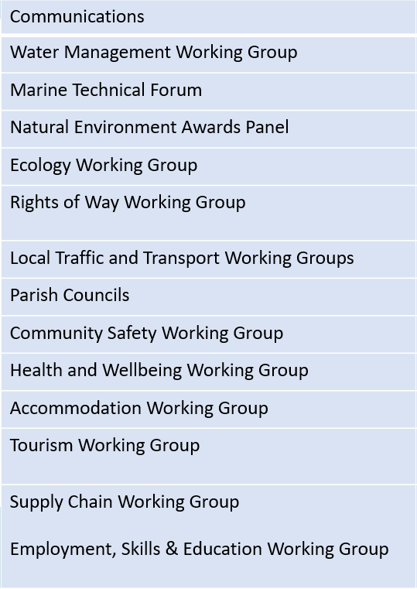
Working Groups
Planning Group
Community Forum (Annual)
Environment Review Group
Delivery Steering Group
Main Development Site
Forum
Transport Review Group
Northern Transport Forum
Social Review Group
Economic Review Group
Southern Transport Forum

Slide 6
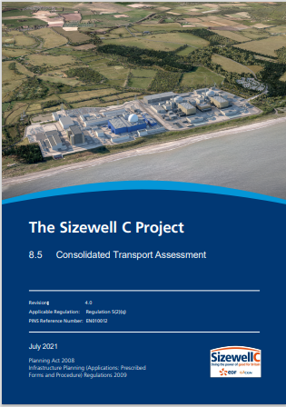
Transport
Transport 60% construction materials by rail and sea
Workers will be encouraged and assigned a designated route to their allocated parking facility
HGVs will follow a designated route – enforced by an onboard tracking system
Local Traffic and Transport Working Groups (inc B1122 and B1125)
Transport Review Group
Northern and Southern Transport Forums
Transport Co-Ordinator
Monitoring
Find these documents at:
The Sizewell C Project | National Infrastructure Planning (planninginspectorate.gov.uk)
Construction Worker Travel Plan
Construction Traffic Management Plan
Traffic Incident Management Plan
Consolidated Transport Assessment

Slide 7
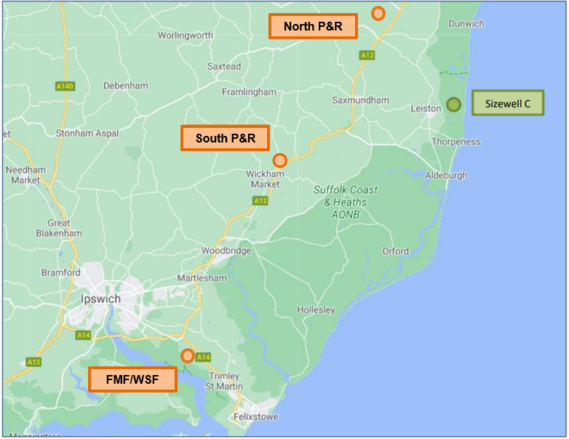
Associated Development Sites
Two Village Bypass – Farnham and Stratford St Andrew
Sizewell Link Road
Green Rail Route
Southern Park and Ride
Northern Park and Ride
Freight Management Facility

Slide 8
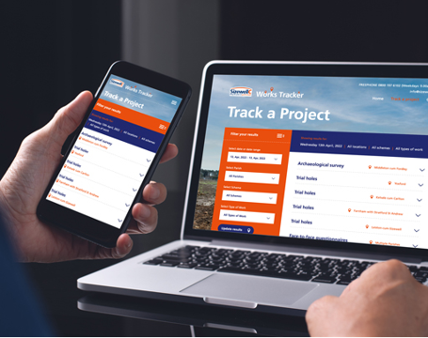
Project updates
New online works tracker to keep local communities informed about surveys and other preparatory works
Contact our Leiston office – info@sizewellc.co.uk or 0800 197 6102

